Slide 1
Comenius University The Faculty of Natural Sciences
Faculty of Natural Sciences
Comenius University
Ilkovičova 6, Mlynská dolina 842 15 Bratislava 4 Slovakia
Web: www.fns.uniba.sk

Slide 2
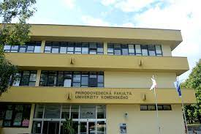
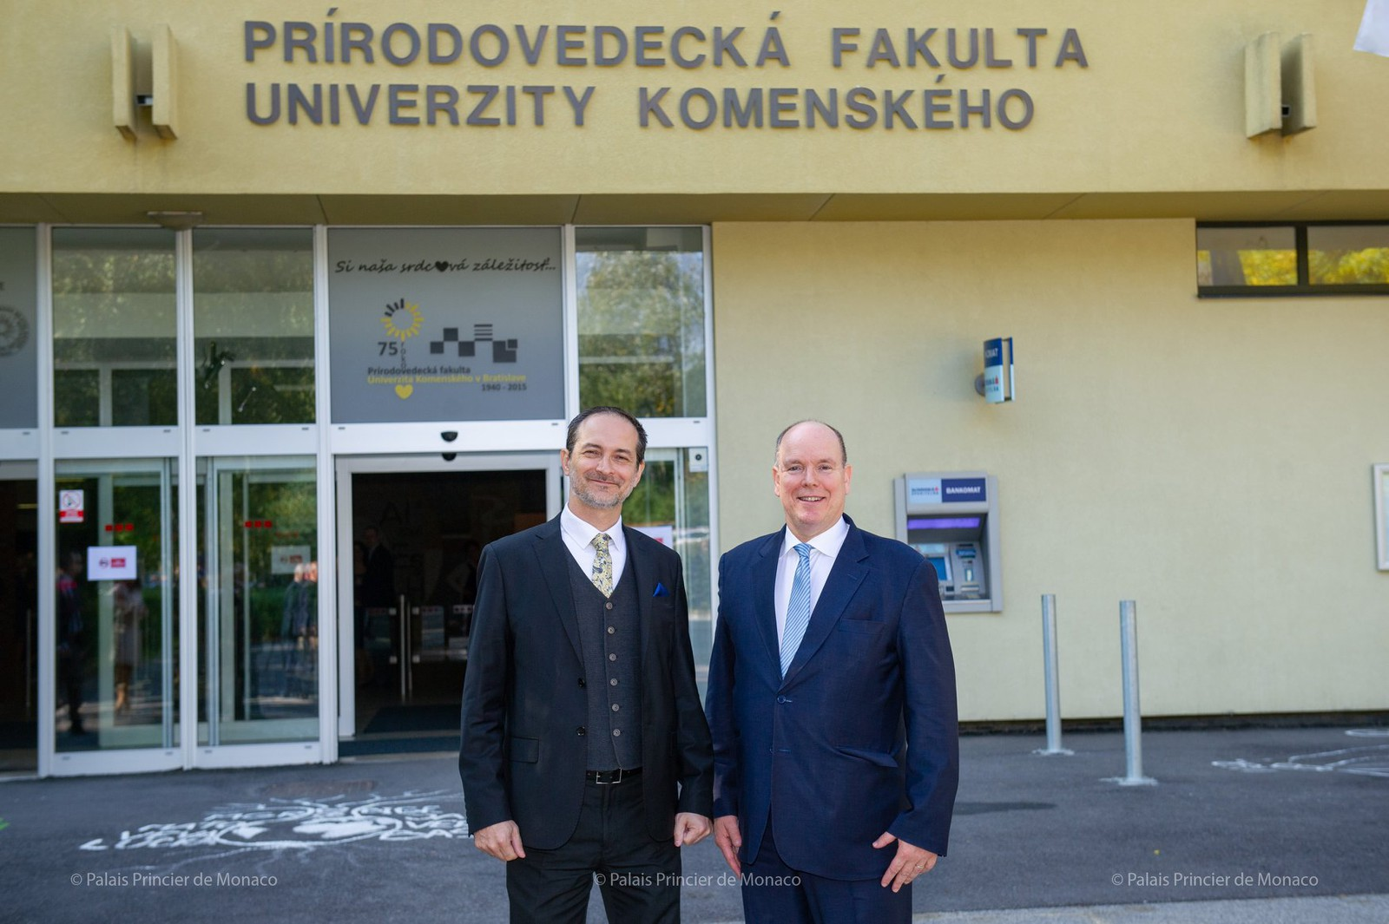
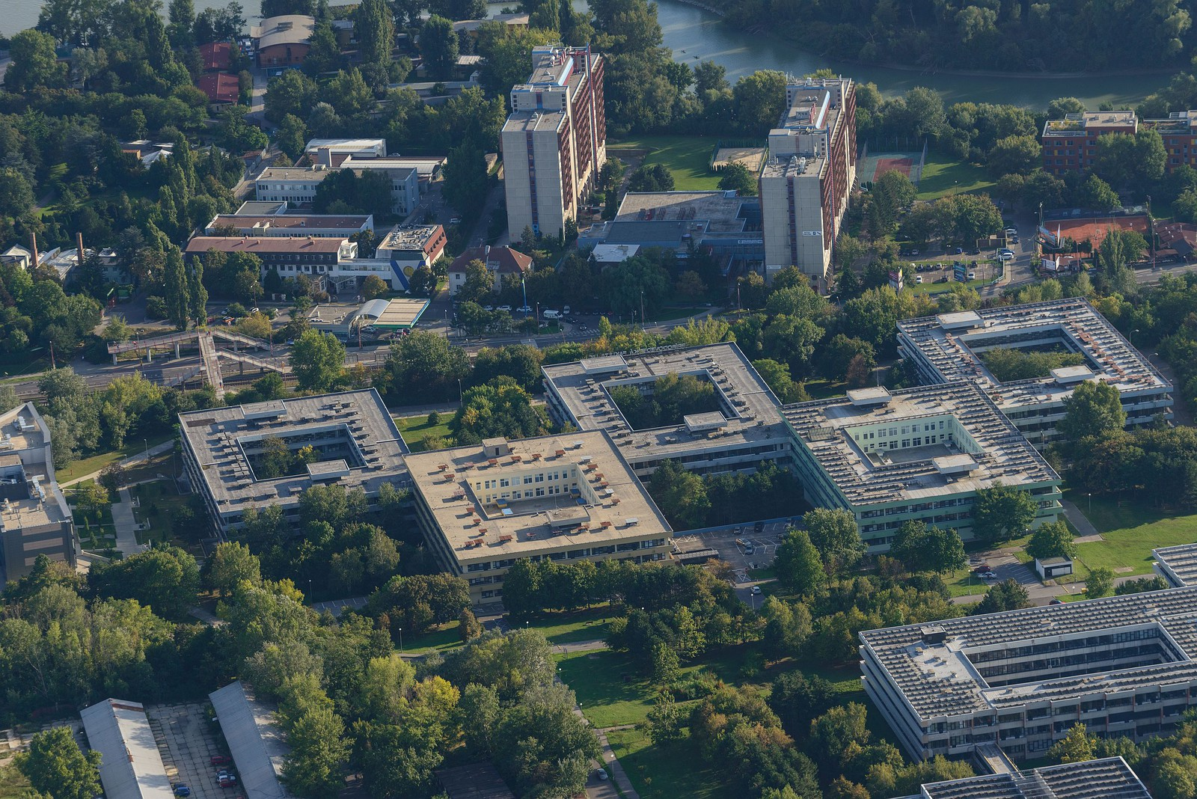
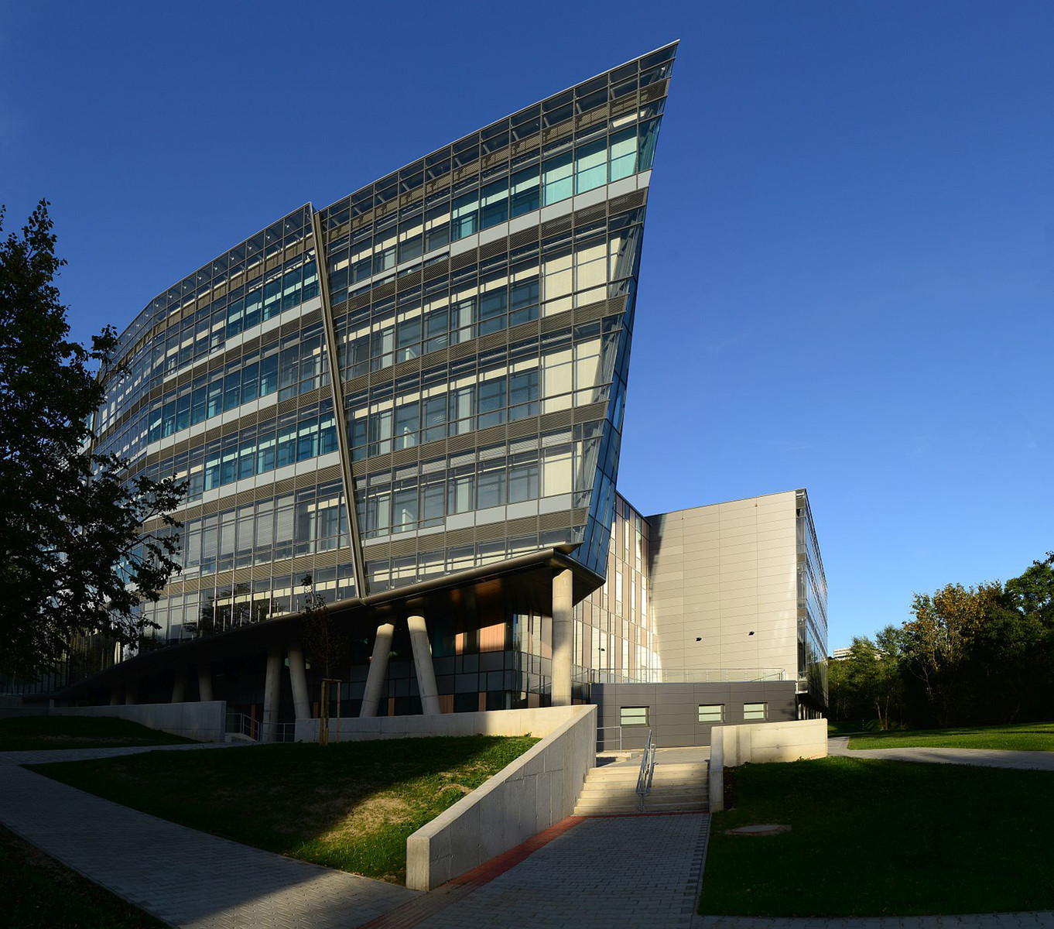

Slide 3
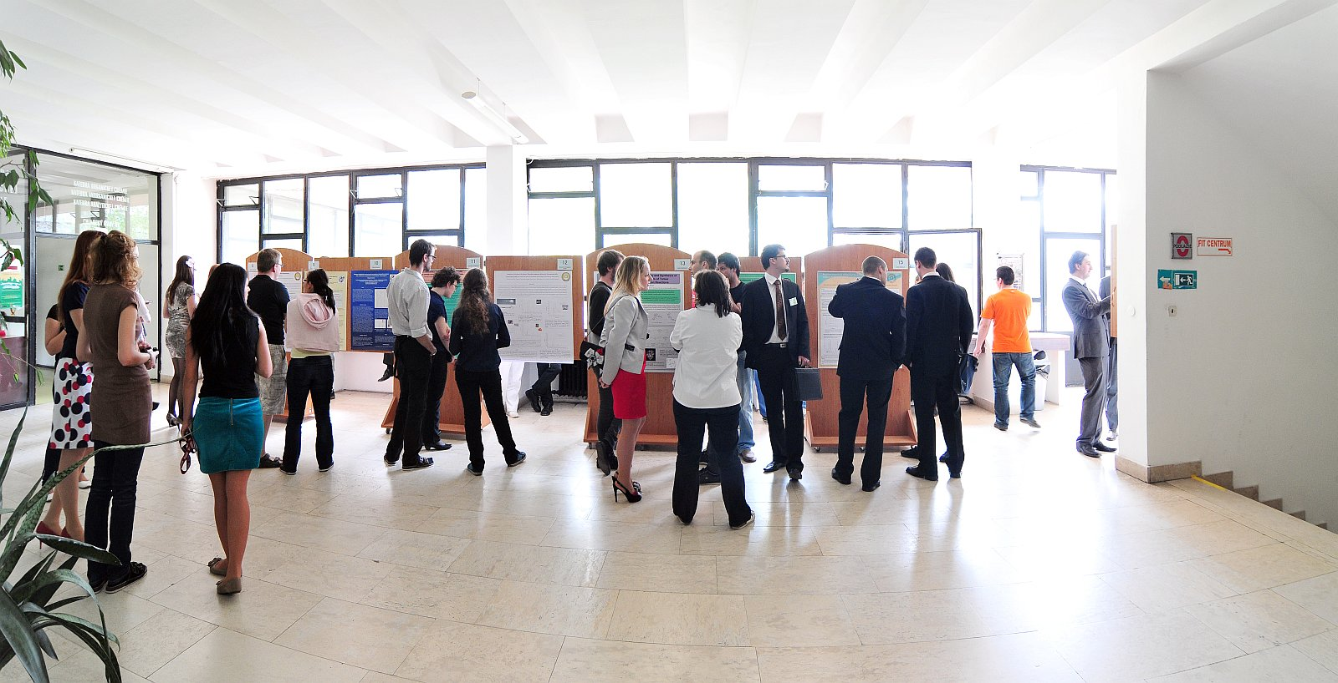
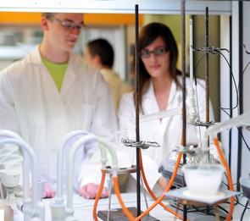
Bachelor Study Programmes [Bc]
Duration: 3 years
Environmental Studies (EN)
Biological Chemistry (EN)
Biochemistry; Chemistry; 3 or 4 years
Biology; Systematic Biology; Medical Biology
Environmental Science
Geography, Geoinformatics and Cartography; Economic Geography, Social and political geography; Geography and Demography; Geography, Regional Development and European Integration,
Geology; Paleontology;
Education

Slide 4
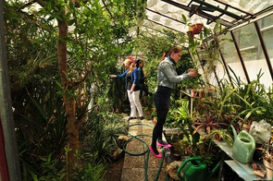
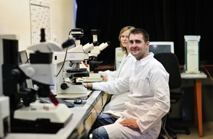
Master Programmes [MSc = Mgr.]
Biology
Duration: 2years
Biology
Botany
Plant Physiology
Animal Physiology
Genetics
Microbiology and Virology
Molecular Biology
Zoology
Biotechnology

Slide 5
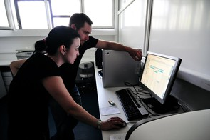
Master Programmes [Mgr.]
Chemistry
Analytical Chemistry
Inorganic Chemistry
Biochemistry
Organic and Bioorganic Chemistry
Physical Chemistry
Nuclear Chemistry and Radioecology
Computational Chemistry

Slide 6
Master Programmes [Mgr.]
Environmental Science
Environmental Geochemistry
Ecology and environment protection
Soil ecophysiology

Slide 7
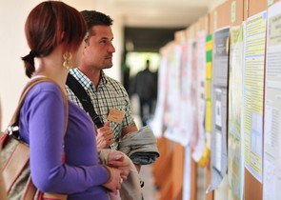
Master Programmes [Mgr.]
Earth Sciences (Geography)
Physical Geography and Geoinformatics
Human Geography and Demography
Regional Geography, Regional Development and European Integration

Slide 8
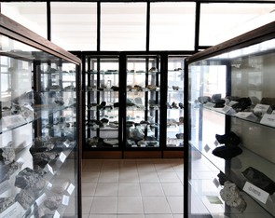
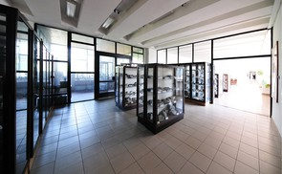
Master Programmes [Mgr.]
Earth Sciences (Geology)
Applied Geophysics
Engeneering Geology and Hydrogeology
Mineralogy, Petrology and Economic Geology
Paleontology
Dynamic Geology

Slide 9
PhD. Programmes
PhD programmes are provided in both Slovak and English language. Graduates obtain Doctor of Philosophy degree (PhD.)
Chemistry – 7 study programmes
Geology – 6 study programmes
Geography – 3 study programmes
Biological Sciences – 8 study programmes
Ecological and Environmental Sciences – 3 study programmes
Biotechnology
Science Education – 2 study programmes
Detailed information:
https://fns.uniba.sk/en/phd-study-programmes/
Application period –15.11.2024, beginning from 1.2.2025

Slide 10
Slovak language course
A Slovak language course for beginners for free
- basic vocabulary and grammar reflects real life situations.
Name of the course: Slovak language for foreigner students
Length of the course: 1-4 semesters, twice a week for 60 minutes

Slide 11
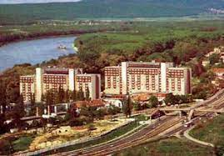
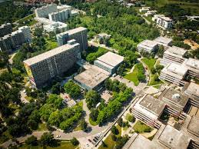
Accommodation for students of the Faculty of Sciences
There are two university hostels:
„Družba“ dormitory is located in the immediate vicinity of the faculty,
„Mlyny“ dormitory is about a 15 minutes walk from the faculty.
https://fns.uniba.sk/fileadmin/prif/phd/english/accommodation.pdf

Slide 12
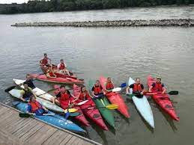
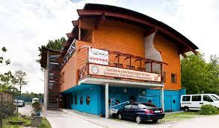
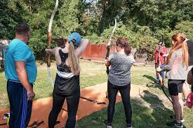
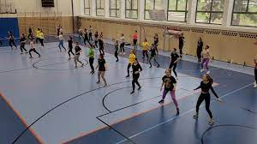
Hope to see you soon in Bratislava In a case you have questions dont hesitate to contact us marianna.kovacova(at)uniba.sk

